Slide 1
Lab. 09
Logic Design Lab.
Spring 2018
Prof. Chang-Gun Lee
(cglee@snu.ac.kr)
TA. WonJae Jang
TA. Wonseok Lee
TA. Alena Kazakova
TA. Dongwan Kang
(ta@rubis.snu.ac.kr)

Slide 2
Contents
Synchronous Binary Counter
Frequency Divider
Implementation Guide
Implementation on Logic Design Board (practice06)
Lab
Appendix: Stop Watch

Slide 3
Synchronous Binary Counter

Slide 4
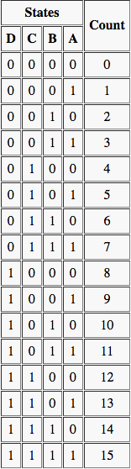
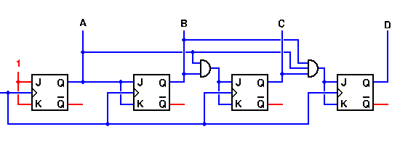
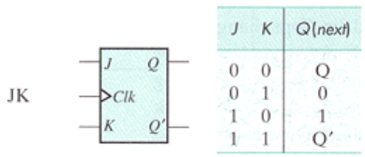
4-bit Counter – JK Flip Flop Implementation
Notes:
http://www.play-hookey.com/digital/counters/synchronous_counter.html
To determine the gates required at each flip-flop input, let's start by drawing up a truth table for all states of the counter. Such a table is shown to the right.
Looking first at output A, we note that it must change state with every input clock pulse. Therefore, we could use a T flip-flop here if we wanted to. We won't do so, just to make all of our flip-flops the same. But even with JK flip-flops, all we need to do here is to connect both the J and K inputs of this flip-flop to logic 1 in order to get the correct activity.
Flip-flop B is a bit more complicated. This output must change state only on every other input clock pulse. Looking at the truth table again, output B must be ready to change states whenever output A is a logic 1, but not when A is a logic 0. If we recall the behavior of the JK flip-flop, we can see that if we connect output A to the J and K inputs of flip-flop B, we will see output B behaving correctly.
Continuing this line of reasoning, output C may change state only when both A and B are logic 1. We can't use only output B as the control for flip-flop C; that will allow C to change state when the counter is in state 2, causing it to switch directly from a count of 2 to a count of 7, and again from a count of 10 to a count of 15 — not a good way to count. Therefore we will need a two-input AND gate at the inputs to flip-flop C. Flip-flip D requires a three-input AND gate for its control, as outputs A, B, and C must all be at logic 1 before D can be allowed to change state.
The resulting circuit is shown in the demonstration below.

Slide 5
Frequency Divider

Slide 6
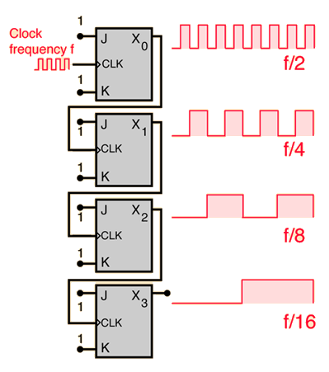
Frequency Divider – JK Flip Flop Implementation

Slide 7
Implementation Guide

Slide 8
Two-Digit-Counter Structure
50MHz Oscillator
TDC Main
Frequency Divider
4-Bit Counter
BCD to 7 Segment
7 Segment Display
Tactile Switch

Slide 9
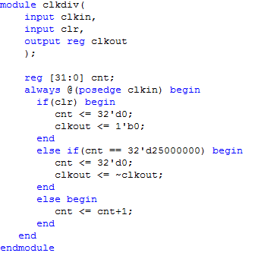
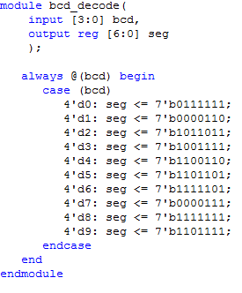
Sample Code (Behavioral Description)
Frequency Divider
BCD to 7-Segment Decoder

Slide 10
Implementation on Logic Design Board (practice06)

Slide 11
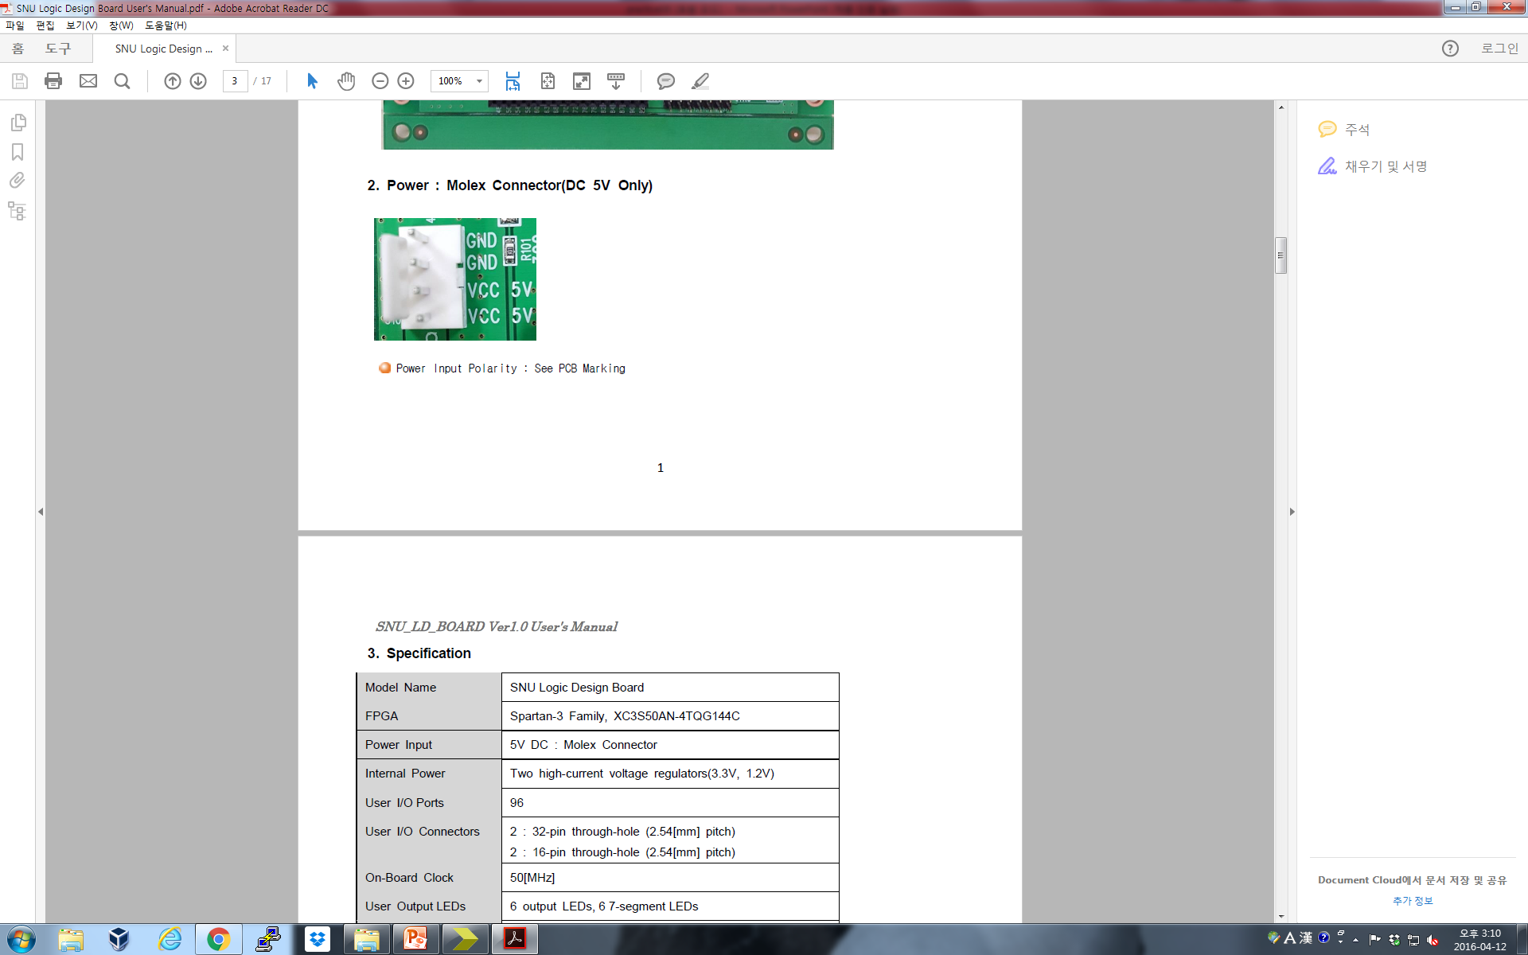
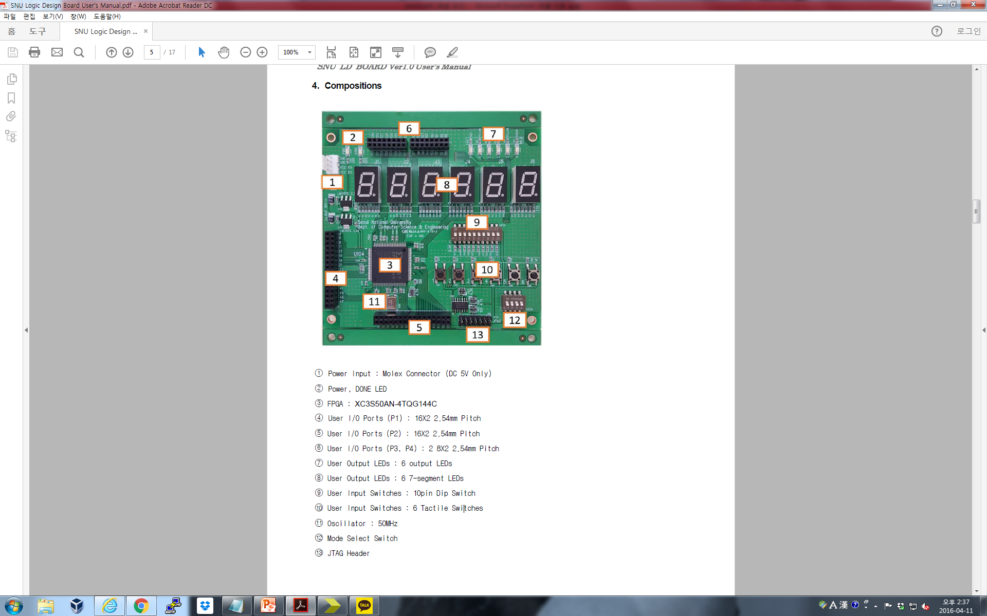
RECAP: SNU Board (Review)
11

Slide 12
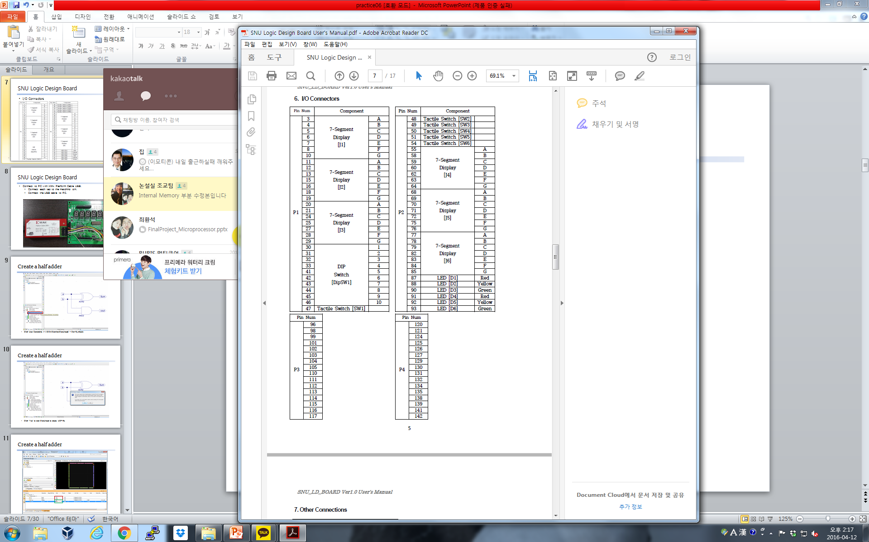
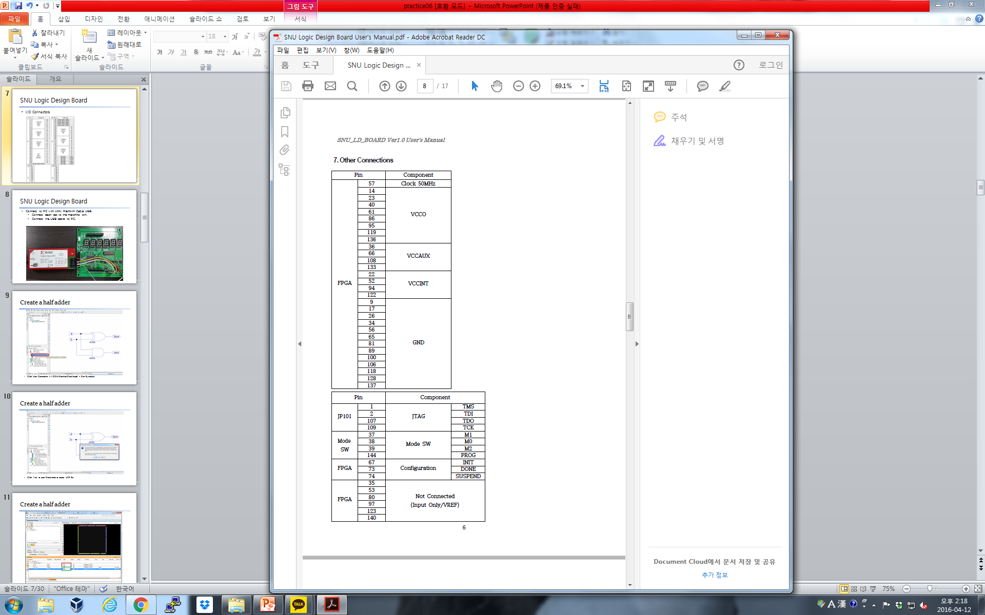
Pin Number Mapping (Review)

Slide 13
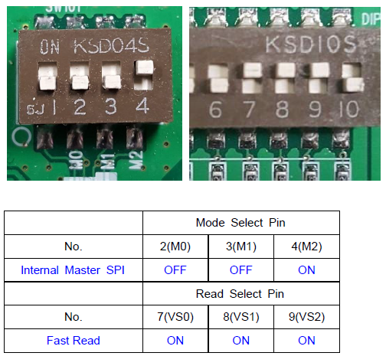
Mode Select (Review)

Slide 14
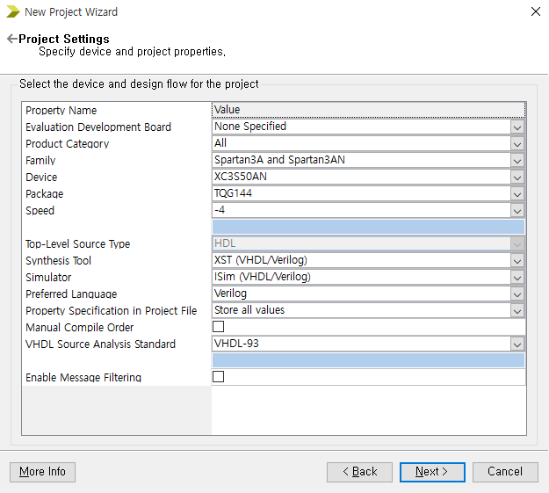
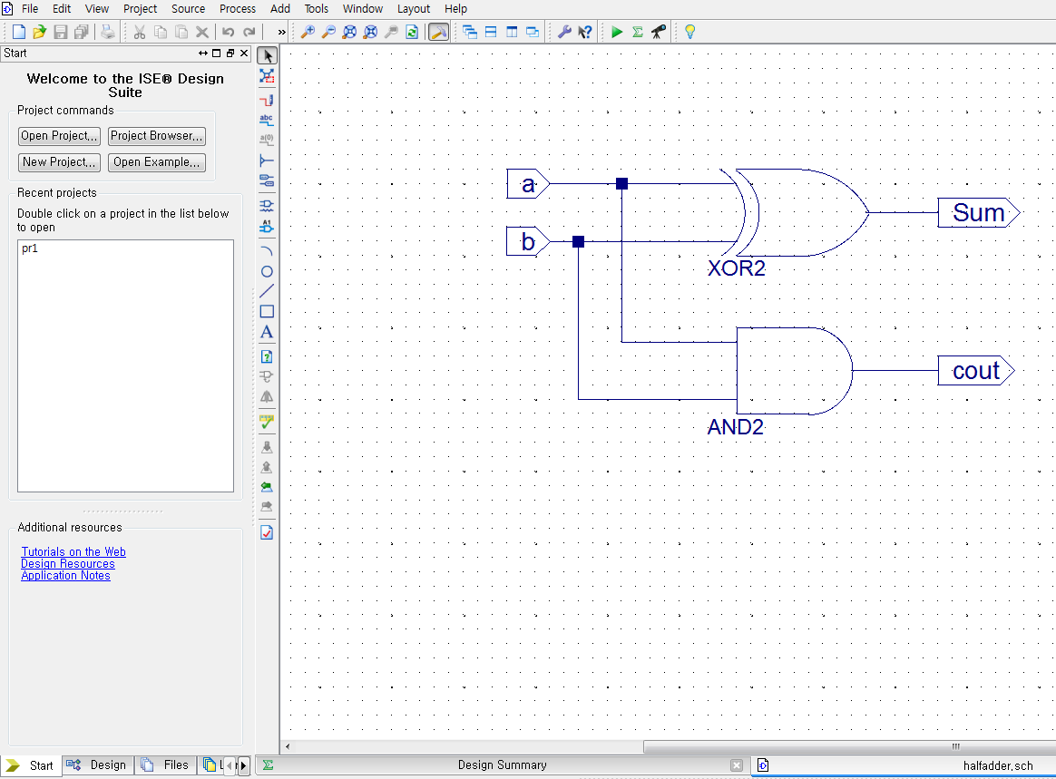
Sample Implementation (Review)
Create new project, build a half adder schematic.
For detailed settings, refer to guidelines in Lab03.

Slide 15
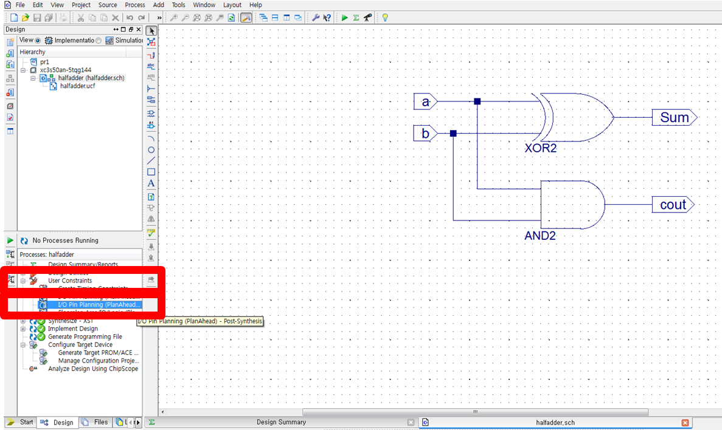
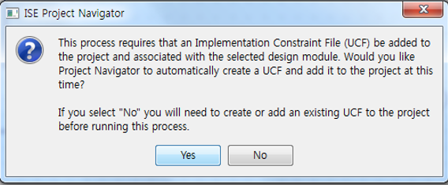
Sample Implementation (Review)
Design tab > User Constraints > I/O Pin Planning(PlanAhead) – Post-Synthesis.
Click ‘Yes’ to start PlanAhead, and to create an UCF file.

Slide 16
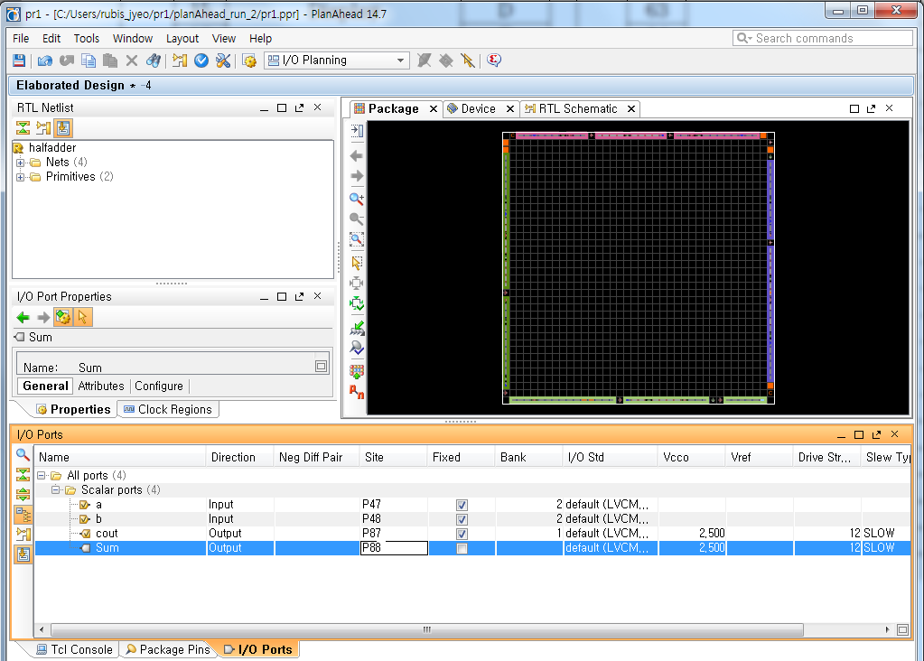
Sample Implementation (Review)
Assign I/O pins for the half adder
RUBIS

Slide 17
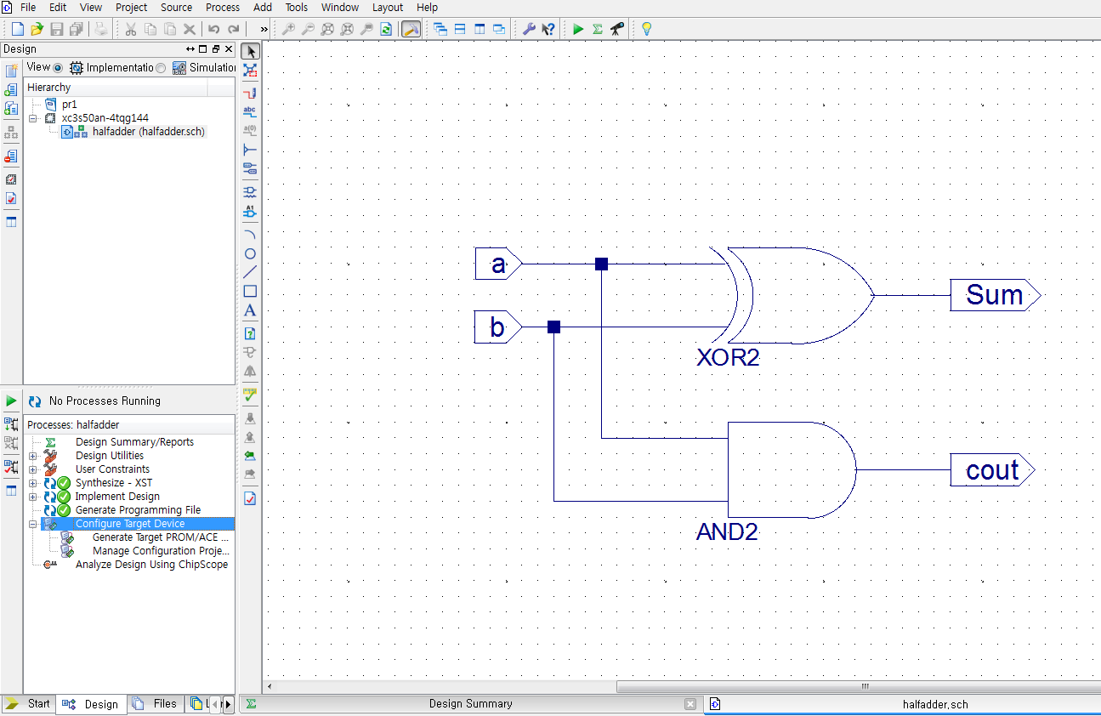
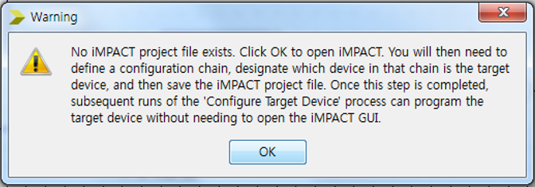
Sample Implementation (Review)
Design tab > double click Configure Target Device
Click OK to create an iMPACT file.
RUBIS

Slide 18
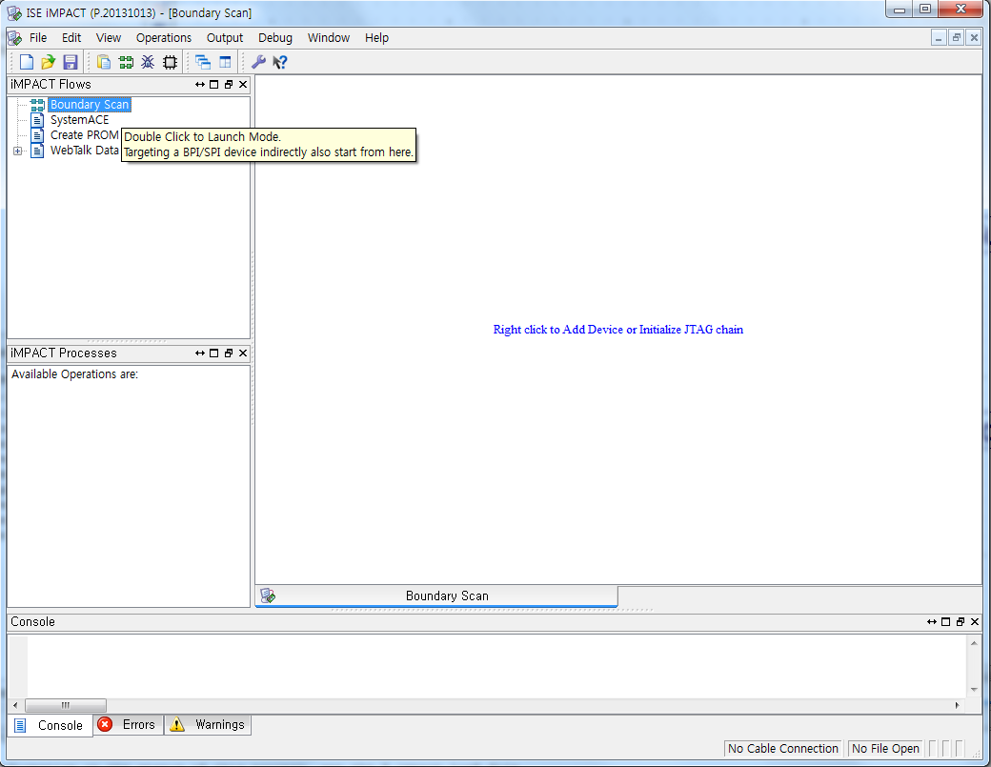
Sample Implementation (Review)
Double click “Boundary Scan”.
RUBIS

Slide 19
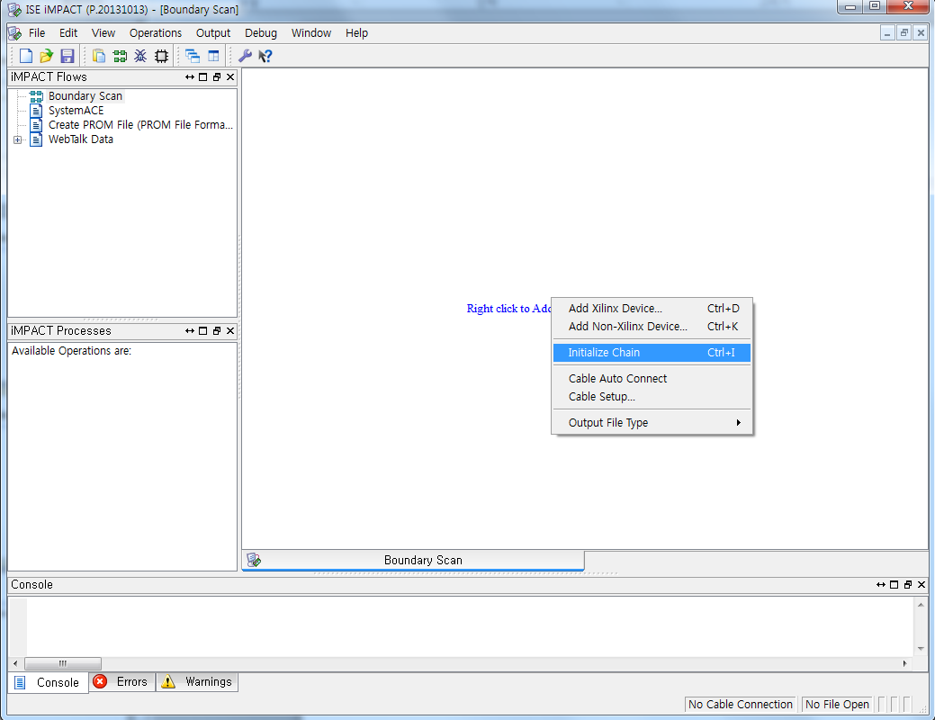
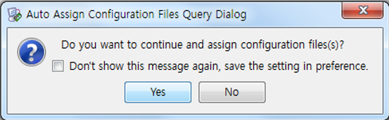
Sample Implementation (Review)
Right click on the right window > click ‘Initialize Chain’.
RUBIS

Slide 20
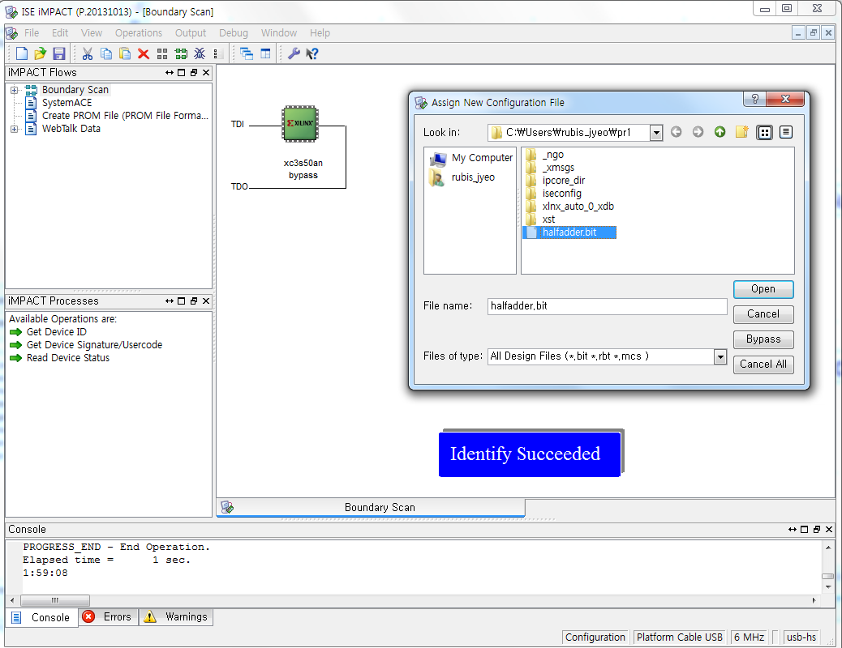
Sample Implementation (Review)
Choose the schematic source you’ve written.
RUBIS

Slide 21
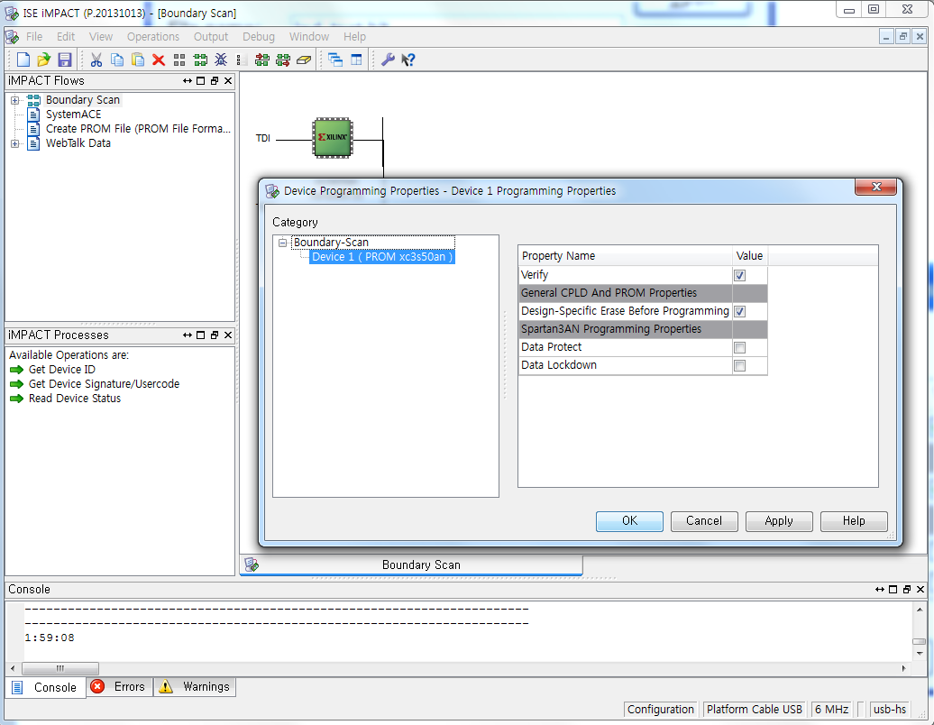
Sample Implementation (Review)
Check settings > ‘OK’.
RUBIS

Slide 22
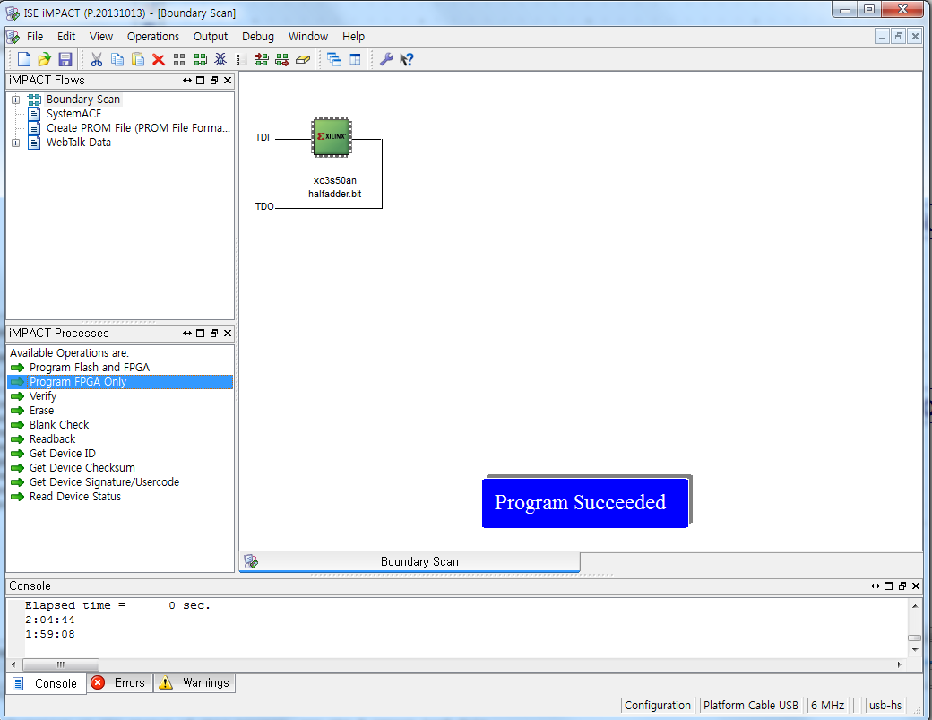
Sample Implementation (Review)
Program FPGA Only > Program Succeeded
RUBIS

Slide 23
Lab

Slide 24
Today
Implement the Two-Digit-Counter in Verilog. It should start from 0, and increment 1 every second. When it reaches 99, the counter should be reset. Additionally, your back to 0 when the signal is HIGH. implementation should handle external reset signal, it should set the counter
Upload your implementation to the Logic Design Board. Use 50MHz oscillator(pin 57) as clock input, and a tactile switch(pin 47) as reset button. Also, use two 7-segment displays as your two-digit output.

Slide 25
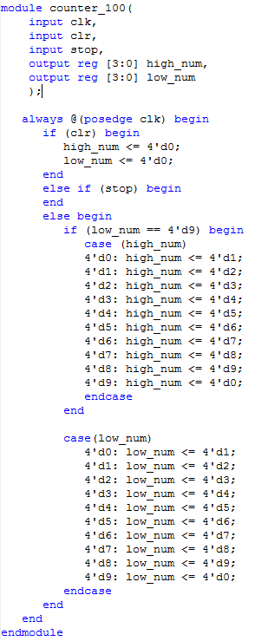
Sample Code (Behavioral Description)
100 counter

Slide 26
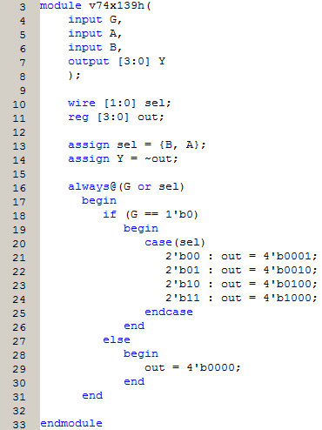
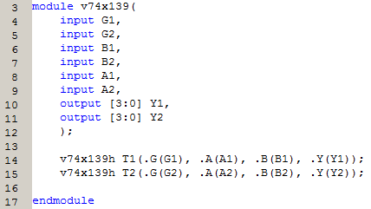
RECAP: Unifying Modules (practice04)

Slide 27
Homework
Upgrade your Two-Digit-Counter to handle external ‘toggle’ signal, that makes your Two-Digit-Counter count backwards, when set HIGH. Implement in Verilog.
2. Upload your implementation to the Logic Design Board (Optional.)

Slide 28
Report
Write a report
# of pages doesn’t matter
Documents should be submitted as PDF file.
All the files should be compressed to ZIP format.
The file size should be less than 15Mb.
Due : May, 29th (Before class begin at 7:00pm)

Slide 29
No class on May 22. (Buddha’s birthday)

Slide 30
Appendix: Stop Watch

Slide 31
Stop Watch: System Controller Approach
Design a “stop watch” that can measure times taken for two events
Inputs
CLK = 50MHz
RESET: Asynchronously reset everything
X: comes from push button
First Push: Start timer
Second Push: Store the time taken for the first event
Third Push: Store the time taken for the second event
SEL: select output (High: first event time, Low: second event time)
Outputs
Two decimal digits to be connected to two seven segment displays
Can display 00 ~ 59

Slide 32
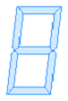
Overall Architecture Design
CLK
TENSEC
SEC
RESET
X
SEL
Which LBB (Logic Building Block) and how many?
How to decompose the whole system into data part and control part?

Slide 33
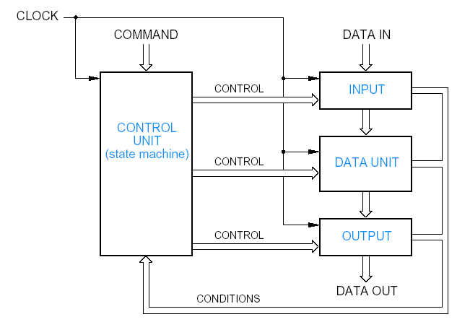
Design System Architecture
First step: divide the system into a control unit and data unit
Data unit – stores, routes, combines, and generally process data
Control unit – starting & stopping the process, testing conditions, and deciding what to do next

Slide 34
Not Today
Design the stop watch in previous slide
Implement in Verilog, load & verify it on the Logic Design Board.
Not Homework
1. Briefly explain the structure of a microprocessor.

